Slide 1
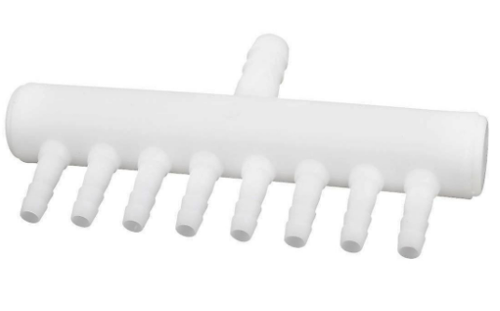
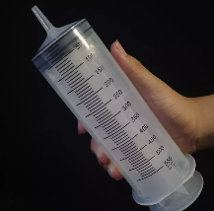
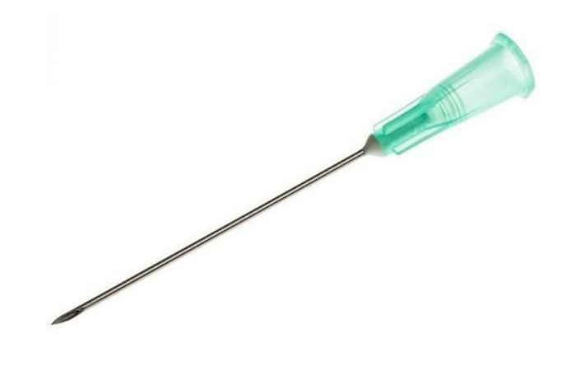

Slide 2
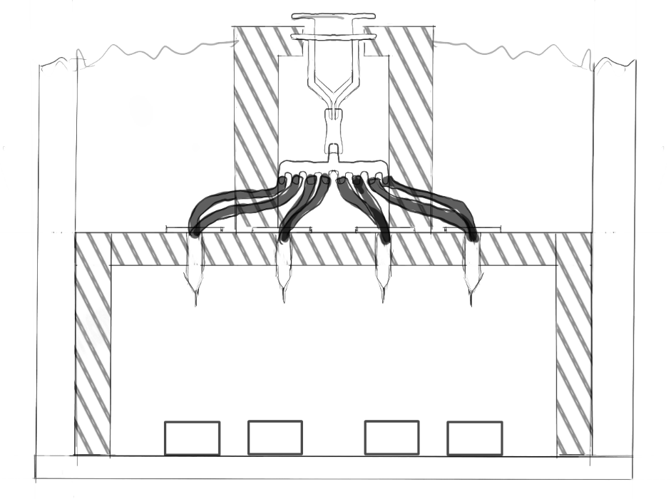

Slide 3
product | qty | price
big syringe | 1 | 8,01
tube | 20 cm | 1,99
tubesplitter | 1 | 9,94
syringe needles | 10 | 5,28
wood | scrapwood from school
filament | leftover from the photobox
screws | leftover from the photobox
total |  | 25,22

